Slide 1


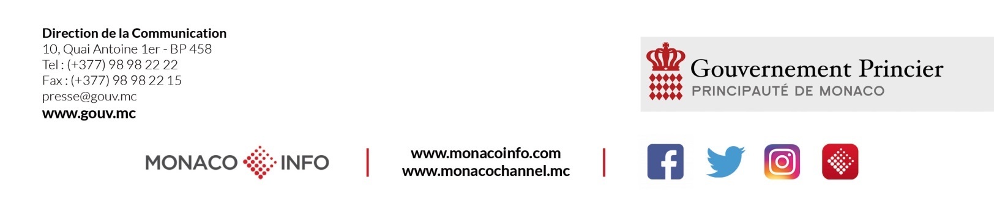
2019/2020 SEASON
PRE-SEASON
PRESS CONFERENCE
Monaco, 10 September 2019 – Gaston Médecin Hall

Slide 2
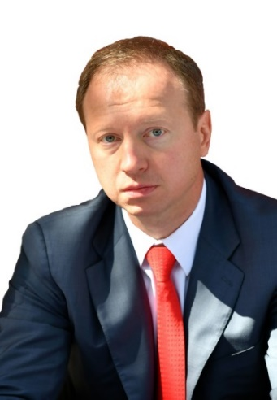
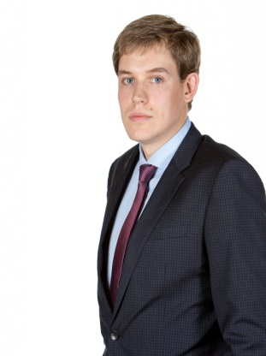
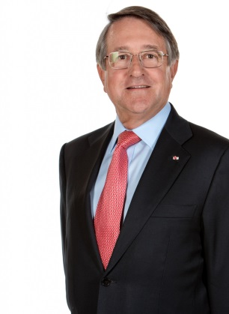
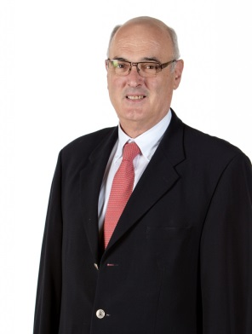
Club Management
CLUB MANAGEMENT
PRESIDENT SERGEY DYADECHKO
Sergey Dyadechko was born in Donetsk, Ukraine, on 18 November 1974. As a student, he played for the Donetsk University basketball team. He became President of AS Monaco Basket in 2013, when the team was playing in NM1 (France’s third national division).
The following season, the Monegasque team were NM1 champions and moved up to the Pro B league, before being promoted directly to the Pro A league the year after that. In its first year in the elite league, the Roca Team won the Pro A regular season, reached the play-off semi-finals and scored their first Leaders Cup. Thanks to their commitment, the Roca Team enjoyed a remarkable season last year, reaching the finals of the French Championship play-offs and the EuroCup Top 16.
Executive Director
Oleksiy Yefimov
Vice President
Paul Masseron
Organisation and Security
Pierre Uboldi

Slide 3

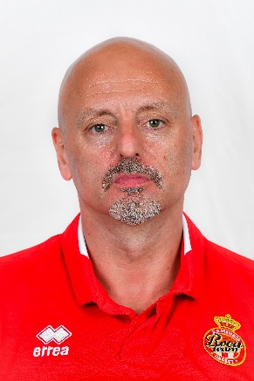
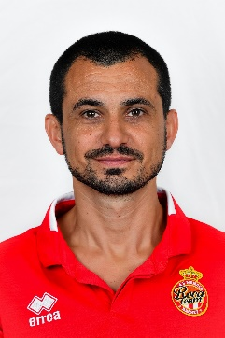
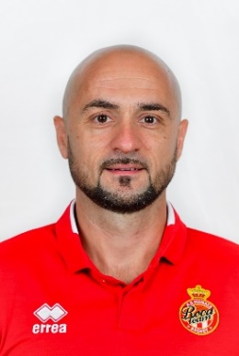
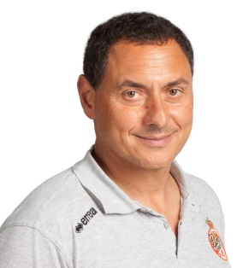
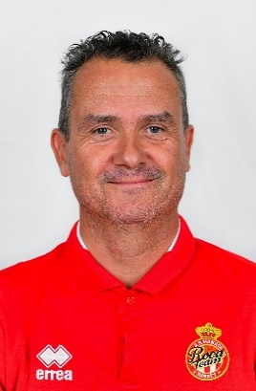
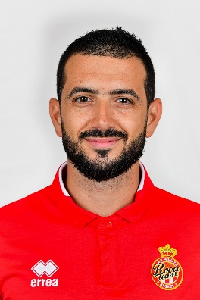
Staff
STAFF
COACH
SASA OBRADOVIC
ASSISTANT COACHES
ALEIX DURAN
MILENKO
BOGICEVIC
PHILIPPE AFRIAT
DOCTOR
JEAN-FRANÇOIS TURPIN PHYSIOTHERAPIST
DIEGO GONCALVES
PHYSICAL TRAINER

Slide 4
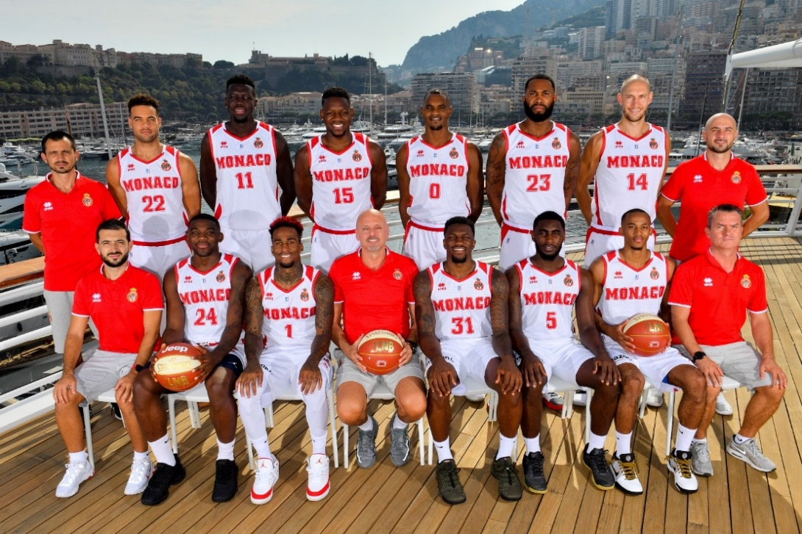
2019/2020 TEAM
 | Name | Country | Position | Age | Height | Weight
#0 | Mehdy NGOUAMA | France | Point guard | 24 | 1.88m | 90kg
#1 | Dee BOST | USA/Bulgaria | Point guard | 29 | 1.88m | 80kg
#5 | Anthony CLEMMONS | USA/Kazakhstan | Point guard | 25 | 1.88m | 88kg
#11 | Landing SANÉ | France | Centre/small forward | 28 | 2.07m | 100kg
#14 | Kim TILLIE | France | Power forward | 31 | 2.11m | 105kg
#15 | Wilfried YEGUETE | France | Power forward | 27 | 2.01m | 107kg
#31 | Dylan ENNIS | Canada/Serbia | Point guard | 27 | 1.88m | 102kg
#22 | J.J. O'BRIEN | USA | Small forward | 27 | 2.01m | 98kg
#23 | Eric BUCKNER | USA | Centre | 29 | 2.08m | 100kg
#24 | Yakuba OUATTARA | France | Small forward | 26 | 1.92m | 100kg
Photo XXXX

Slide 5
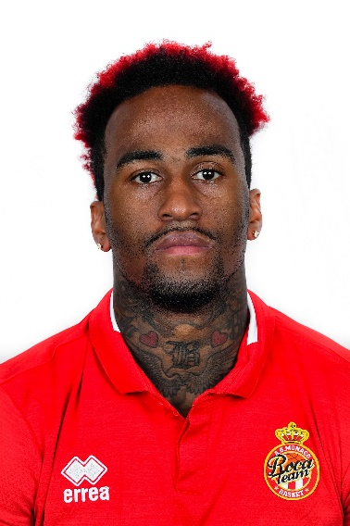
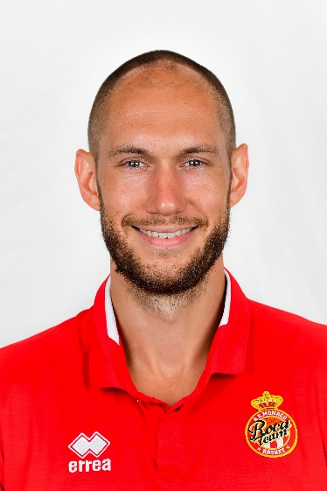
The players
THE PLAYERS
Dee BOST (1.88m – 29 yrs – USA) – Captain – Point guard
After a highly impressive 2016/17 season with AS Monaco, during which he won the Leaders Cup, contributed to the regular season title (13 points, 3 rebounds, 5.6 assists) and picked up bronze in the FIBA Basketball Champions League, Dee Bost headed for the EuroLeague with Žalgiris Kaunas.
A quick, explosive point guard capable of punching through and scoring from a distance (33.7% three-point field-goal percentage in the EuroLeague and 35.3% in the Jeep Elite league), who is skilled at free throws (78% career percentage), Dee Bost is also a very active defender. He is a competitor through and through, and AS Monaco is delighted to have him on the team.
Back at the behest of Saša Obradović, the Captain of the Roca Boys will wear his lucky number 1 jersey.
Kim TILLIE (2.11m – 31 yrs – France) – Power forward
Born on 15 July 1988 in Cagnes-sur-Mer, Kim Tillie naturally made his career debut with US Cagnes before spending a year with the Antibes Sharks junior team. He was 16 when he headed for the French National Institute of Sport, Expertise and Performance (INSEP) in Paris. Two years later, the Côte d’Azur native crossed the Atlantic to join the University of Utah, completing a full programme (four seasons) with the Utah Utes and developing his arsenal.
Since then, Kim has spent five seasons in the EuroLeague, reaching the Final Four in 2016 with Vitoria, winning a bronze medal with the French team in 2014, a European junior championship title in 2006 and getting to the Olympic quarter finals with the French national team in 2016. At the age of 31, he signed to AS Monaco Basket for the season, marking his return to the French championship eight years after his time at Villeurbanne. A huge coup for the Roca Team.

Slide 6
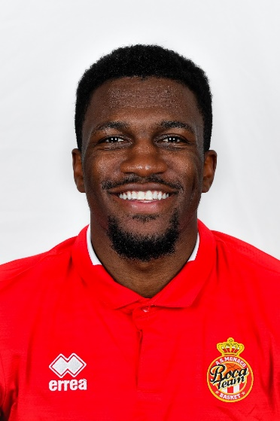
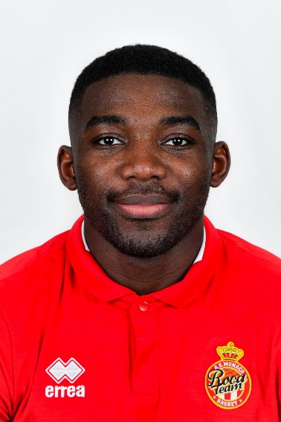
The players
THE PLAYERS
Dylan ENNIS (1.88m – 27 yrs – Canada/Serbia) – Shooting guard
The Canadian-Jamaican, who holds a Serbian passport, went through a number of stages in his training (three high schools and three colleges) before embarking on his professional career in 2017 with KK Mega Bemax (Serbia), the club of his agents. Soon after, in December, he joined neighbouring club Crvena Zvezda in Belgrade, which enabled him to compete in the EuroLeague for several months.
The following season, he played with Andorra in the Spanish league (13.4 points with a 43.6% field-goal percentage, 3 rebounds and 2.7 assists in an average of 25 minutes per game). He finished in the second five of the EuroCup season (12.2 points with a 36.4% field-goal percentage, 3.9 rebounds and 3.5 assists in 25 minutes). He will be competing at the European level once again in 2019/20 with the Roca Team.
Yakuba OUATTARA (1.92m – 26 yrs – France) – Shooting guard
With his contract in the Principality extended for a year, the 26-year-old French international is intent on resuming his very promising career. Returning from a discreet trip to the United States at the end of March 2018, Yakuba Ouattara was only able to play a single match, against Châlons-Reims on 7 April (12 points in 21 minutes, 3 rebounds). Seeking to get back on top form, which he came close to during his first stretch with Monaco, Yakuba Ouattara decided to continue the quest with the club which discovered him.

Slide 7
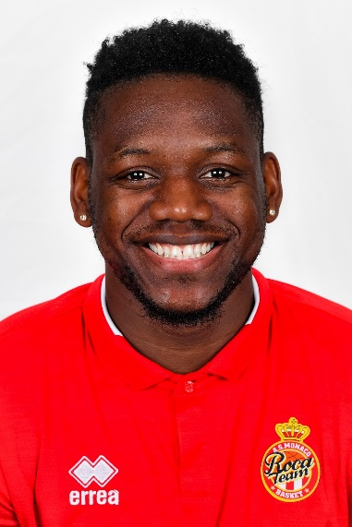
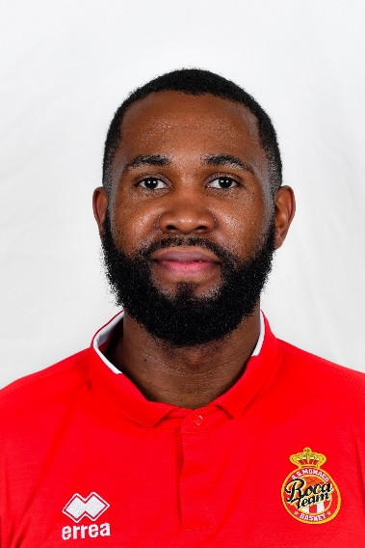
The players
THE PLAYERS
Wilfried YEGUETE (2.00m – 27 yrs -– France) – Power forward
An agile and invigorating front-court player, Wilfried Yeguete has signed with AS Monaco for the next two seasons. He comes to the club from Le Mans, where he fiercely defended the key for three seasons, taking MSB to a fifth French championship title match in June 2018 against none other than AS Monaco, as well as two Cup finals (2017, 2019), the last of which Le Mans lost to Tony Parker’s ASVEL (61–70) in Paris in spring. Last season, the French international averaged 9 points and 7.6 rebounds in 23 minutes per game.
Eric BUCKNER (2.08m – 28 yrs – USA) – Centre
A highly physical and energetic centre, Eric Buckner was discovered at ASVEL in France as a medical replacement for Alpha Kaba at the beginning of the 2018/19 season. After his contract with ASVEL was terminated, he came to strengthen the ranks of AS Monaco. While it was once envisaged that he would return to ASVEL, in the end AS Monaco made a better financial offer during the course of the season. In 53 matches across all tournaments in 2018/19, Buckner, who had previously mostly played in Turkey, averaged 8.7 points with a 64.1% field-goal percentage, 4.4 rebounds and 0.9 blocks in 21 minutes per game.

Slide 8
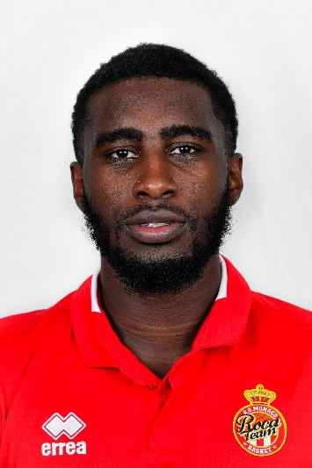
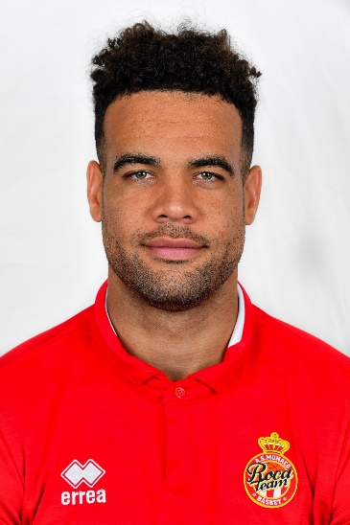
THE PLAYERS
Anthony CLEMMONS (1.86m – 24 yrs – USA/Kazakhstan) – Point guard
Originally from Lansing (Michigan), the home town of the legendary Magic Johnson, and a University of Iowa graduate, Anthony Clemmons has come a long way, becoming... Kazakh, and even playing internationally for his adopted country. After distinguishing himself in the competitive VTB League for Kazakh capital Astana (13.4 points, 5.5 assists, 3.4 rebounds in 2018-19), the playmaker will need to come off the bench to take over from Dee Bost.
An all-round, physical and strong defender, Anthony Clemmons had the opportunity to be noticed by coach Saša Obradović when the latter held the reins at VTB League club Kuban.
J.J. O'BRIEN (2.00m – 27 yrs – USA) - Small forward
Following spells at the University of Utah and San Diego State (10.3 points, 5.2 rebounds as a senior), J.J. O’Brien competed in two regular season NBA matches with Utah Jazz in 2016 before spending most of his career in the G League.
In 2017/18, playing for the Agua Caliente Clippers in California (G League), he had a great season, averaging 15.9 points (35.1% three-point field-goal percentage, 84.3% free-throw percentage), 4.8 rebounds and 3.1 assists, with a few highlights along the way, such as 32 points against the Windy City Bulls on 28 January 2018. Last season, he played in Astana alongside Monaco’s new point guard, Anthony Clemmons.

Slide 9
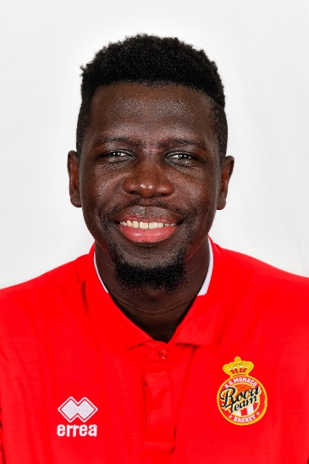
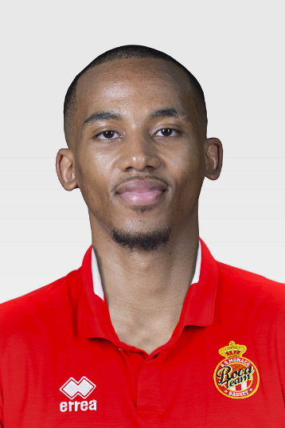
THE PLAYERS
Landing SANÉ (2.07m – 28 yrs – France) – Centre
Born on 19 December 1990 in Ermont, Val-d’Oise, Landing Sané started out as a footballer before taking up basketball at the age of 14 at his home-town club.
Trained at Levallois, where he spent seven seasons (5.8 points, 3 rebounds on average; 8.4 points, 3.7 rebounds during the 2016-17 season), for the 2017/18 season he moved to Reggiana before leaving the Italian club for BC Andorra. Last season, the Ermont native played for three teams: Levallois, Mornar (Montenegro) and Andorra again.
“Landing can really help us meet our objectives,” says Saša Obradović.
Mehdy NGOUAMA (1.88m – 24 yrs – France) – Point guard
Having trained in Nancy, the young point guard first tried his luck in the United States, at junior college then university level for two years. While there, he played for Chipola College and Alabama State University, but due to being ineligible to play in the NCAA, he was forced to return to France. After sitting out one season, he signed to Denain (Pro B), where he showed that he had lost none of his abilities (5.8 points, 1.5 rebounds and 1.4 assists in an average of 14 minutes per game).
Last season, having transferred to Vichy-Clermont, he shone (9.8 points per game), contributing to the good showing of his team, who were eliminated during the play-offs for promotion to the Jeep Elite league.

Slide 10

QUESTIONS FOR COACH SASA OBRADOVIC
HOW HAVE YOU BEEN FEELING SINCE YOUR ARRIVAL IN THE PRINCIPALITY?
From the outset, I’ve been really happy to be working at AS Monaco. I was immediately made to feel very welcome. Working with a club that is ambitious and aspires to grow and achieve top-class results is very motivating. I could have coached a EuroLeague team, but I was attracted to the Roca Team project straight away. And why shouldn’t I compete in the EuroLeague with AS Monaco one day? For now, we’re in the EuroCup. It’s a tough competition which requires a huge amount of effort, and we’re going to do everything we can to put in a good performance there.
WHAT DO YOU MAKE OF THE NEW RECRUITS?
First and foremost, all of the players recruited have great personalities. Going beyond basketball, they are supposed to be strong individuals. It’s a completely new team. They need to adapt to certain rules, make a certain contribution and play as a team, not individually, which is the worst possible approach. We want everyone to feel invested and important, with each player playing for his teammates. That’s the main rule. Individual statistics do not offer a path to victory; the most important thing is to have a good defence and an effective team. We are making progress every day. The basics are extremely important, and it’s essential to work on those all the time. The key thing, now, aside from tactics, is team cohesion.

Slide 11
QUESTIONS FOR COACH SASA OBRADOVIC
WHAT ARE THE CHALLENGES AND OBJECTIVES FOR THE COMING SEASON?
To achieve great results, you need to have strong objectives. That’s why we always aim high, even though we prefer not to talk about it too much. Our goal is to win championships, but that depends on a lot of factors. Every day brings its own trial: my aim is to offer the best coaching possible for the next day, and so on and so on. On the court, we have a new team, they need to gain in confidence. The players are getting to know each other, and we need to find the best way of playing in accordance with our skills, so that we can find our comfort zone.
WHAT DO YOU THINK OF THE ROCA TEAM’S GROUP FOR THE EUROCUP?
We’re going to be competing against ambitious teams, backed up by good organisations. Ulm is a club which has been playing at a high level for several seasons and has some great players. In addition, the German club has a great fan base. Last season, Andorra beat ASVEL to reach the EuroCup semi-finals – that was a historic victory for them. They have also put together a very solid team this season and they will be tough opponents. The Israeli clubs play in a quality league. Rishon also has a good coach, who is a friend of mine. Our goal will not just be to reach the Top 16, we want to go as far as possible. The EuroCup will be tougher than last season. There will be lots of good teams in there, like Bologna, one of the top favourites, who we will play in the group stages. You need only look at their recruitment: they spent a huge amount of money to attract NBA point guard Miloš Teodosić. We will set our sights high and we will try to do better each game.

Slide 12

CONQUERING EUROPE
THE EUROCUP
The Roca Boys did not disgrace themselves in their first EuroCup appearance last season, even managing to score a victory on the Crvena Zvezda court in Belgrade. Qualifying for the second round of the competition, the Top 16, the Monegasque team had an opportunity to take on some of the best teams in Europe and gain experience.
This season, the Monegasques once again find themselves in Group A, and will face Virtus Bologna (FIBA Basketball Champions League defending champions), MoraBanc Andorra (sixth in the regular Spanish Championship), Maccabi Rishon LeZion (runner-up in Israel), Ratiopharm Ülm (sixth in the regular German Championship) and Greek side Promitheas Patras (who reached the final sixteen in the Basketball Champions League last season).
The regular season gets underway on Tuesday 1 October. The top four teams in each group will qualify for a further group stage, the Top 16. The top two teams in each Top 16 group will then go on to the quarter finals. From this round onwards, the eight teams in contention compete head-to-head in series of three games. The winners will qualify for the semi-finals, then the final, which also retains the same format.

Slide 13
SEASON HIGHLIGHTS
Jeep® ÉLITE FRENCH CHAMPIONSHIP
The Roca Team will face Gravelines in their first match of the regular season at 6.30 pm on Saturday 21 September at Gaston-Médecin.
Jeep® ÉLITE games officially begin at 8 pm on Saturdays, but Monaco has been granted dispensation to play its games on Saturdays at 6.30 pm.
Monaco’s results in the Jeep® ÉLITE league were impressive last season. The club reached the finals by competing in seven epic games against Lyon-Villeurbanne.
The first leg of the repeat of the Jeep® ÉLITE finals between Monaco and Lyon-Villeurbanne will take place in Week 17, on 4 January 2020, in Monaco. The return leg at the Astroballe is scheduled for 29 February 2020.
7DAYS EUROCUP
This time round, AS Monaco Basket will be taking a legend of Italian basketball: Virtus Bologna. Last season, this illustrious team, which has twice won the EuroLeague (in 1998 and 2001), returned to the top flight by winning the FIBA Basketball Champions League (with a victory over Tenerife in the final). The first leg will be played on 30 October in Bologna, with the return game on 18 December at Gaston-Médecin.
In 2018/19, AS Monaco Basket took a decisive step by rejoining the EuroLeague Basketball family, a world leader in basketball, sport and entertainment, which manages the best European competitions for professional basketball clubs using a unique and innovative organisational model. In its first appearance in the EuroCup competition, AS Monaco Basket finished among the top 16 competing clubs.
OTHER COMPETITIONS
The Roca Team will play its first French Cup match in Le Mans on 17 September.
The All-Star Game will be held at the AccorHotels Arena on 29 December, and the Disneyland Paris Leaders Cup LNB, which, for the eighth consecutive season, will bring together the top eight teams from the first half of the season, will be held at the Disney® Events Arena from 14 to 16 February 2020.
PRE-SEASON ROUND-UP
To complete its preparations, AS Monaco took part in the Gloria Smart Casual Cup in Antalya, Turkey, where the team lost to Kazan in the final (64–71), conceding their only defeat in seven pre-season games. A good omen before the beginning of the official season.

Slide 14
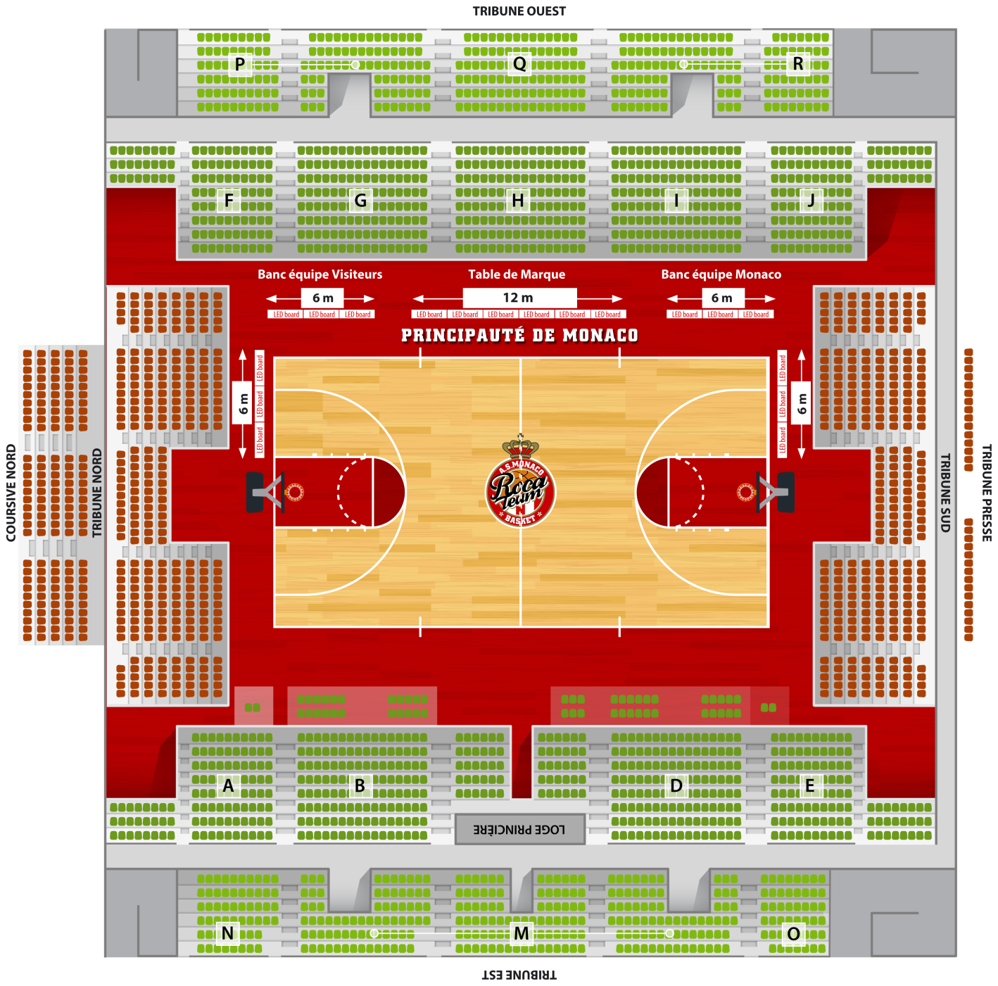
MAP OF THE GASTON MEDECIN HALL
Press access via the Louis II Stadium parking area.
Hall capacity: 3,000 (30 seats for journalists)
Management team:
André Vatrican (Avatrican@Gouv.Mc / 98 98 22 11)
Stephan Laforest De Minotty (Slaforest@Gouv.Mc / 98 98 22 29)

Slide 15
AGREEMENT BETWEEN AS MONACO BASKET AND THE PRINCE’S GOVERNMENT
Launched in 2016, the Prince’s Government’s new communications strategy is implemented by the Government Communication Department. One of the first measures under this strategy was to allocate the communications resources that for many years have been devoted to the institutional campaign – which has now achieved its objectives – in a different way.
Consequently, a portion of the resources initially earmarked for the institutional communications campaign has been allocated to the professional basketball club for the 2019/20 season. Continuing this strategy, the partnership has been renewed this season and will aim to:
  support the club’s sporting objectives;
  help the team to convey the “Monaco” message;
  assist the club in its relationships with competitor clubs, and national and international governance bodies;
  pool resources in order to improve services for the media.
An agreement was drawn up setting out the terms of this partnership, whose aim is to provide institutional support on governance and communications issues.
In specific terms, it:
makes operational resources available to the club, including press officers from the Government Communication Department as well as journalists and/or camera operators, content producers and the Government Communication Department Liaison Officer;
supports clubs to:
  identify and equip working areas for media representatives and arrange access to them;
  put in place a reception service for media representatives during national and international games;
  advise and help the club to create and/or develop communications tools that will improve the link with the fan community (visual identity, communications messages, Web TV, Internet and social media, link with the websites of federal bodies, etc.);
  offer a presence/spokesperson during games involving foreign relations to welcome the managers of opposing teams, representatives from sporting bodies and other personalities.
The partnership involves a financial contribution of €1.5 million to all of the club’s communications and public relations activities.
Media visibility of the Roca Team during the 2017/2018 season
The study carried out by KANTAR MEDIA during the period from 1 August 2018 to 30 June 2019 for the written press, Internet, radio and television highlighted:
  177 media mentions;
  media impact of 79.9 million contacts;
  equivalent of purchasing €3,241,148 in advertising space.
These results show strong media support for the Roca Team.
We thank the media for this and hope that they will continue to follow us again this season.

Slide 16
CONTACTS
AS MONACO BASKET
Louis II Stadium, 7 Avenue des Castelans,
98000 MONACO
Tel.: 03 77 92 05 40
Fax: 03 77 92 05 97
Website: http://www.asmbasket.org
Email: monacobasket@monaco.mc
GOVERNMENT COMMUNICATION
DEPARTMENT
10 bis, Quai Antoine I,
98000 Monaco
Tel.: (+377) 98.98.22.22
Fax: (+377) 98.98.22.15
Email: avatrican@gouv.mc / slaforest@gouv.mc
Management team:
André Vatrican (+377 98 98 22 11)
Stephan Laforest De Minotty (+377 98 98 22 29)

Slide 17

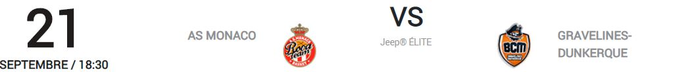
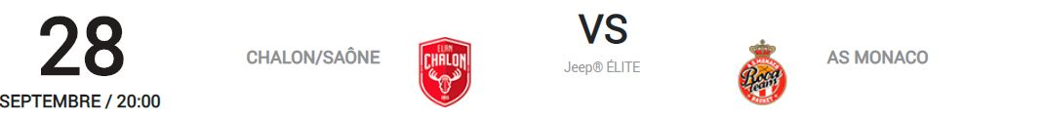

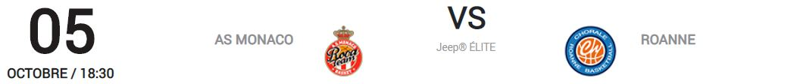
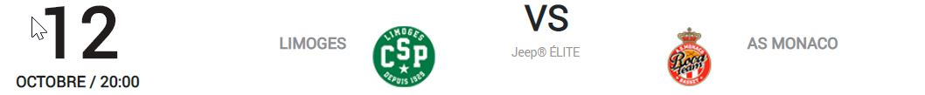
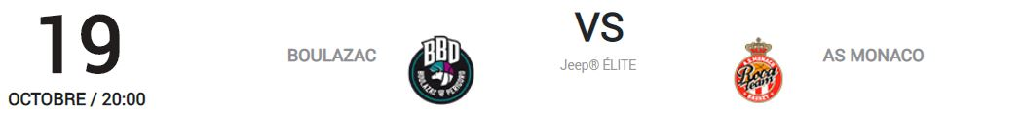
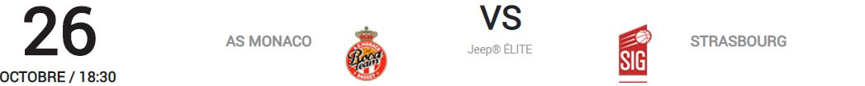
APPENDIX 1: OFFICIAL JEEP ELITE SCHEDULE

Slide 18

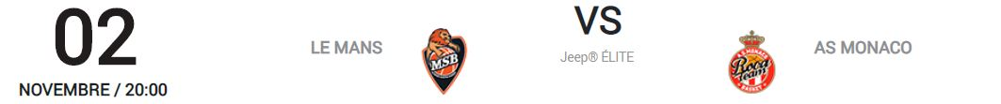
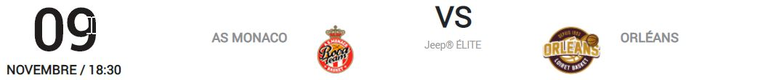
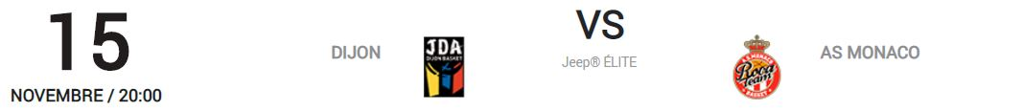
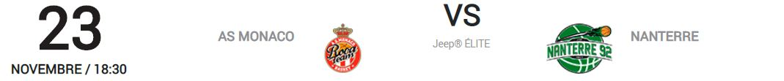
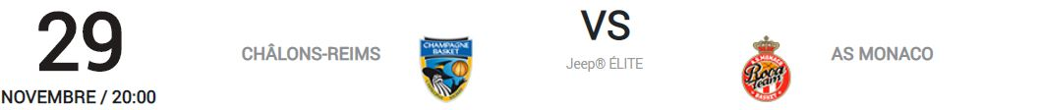
APPENDIX 1: OFFICIAL JEEP ELITE SCHEDULE

Slide 19

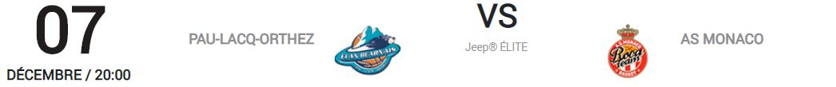
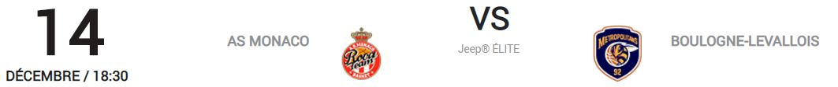
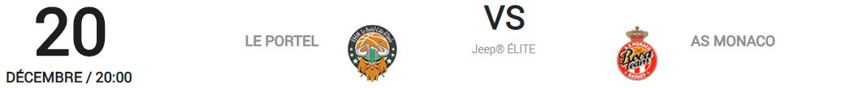
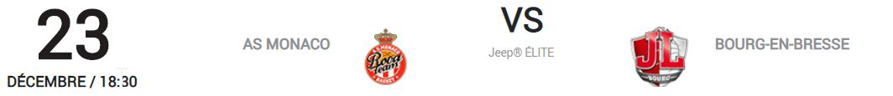
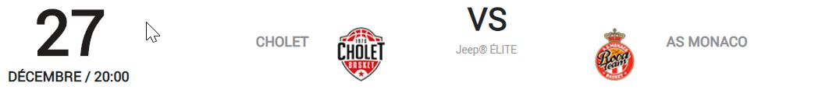
APPENDIX 1: OFFICIAL JEEP ELITE SCHEDULE

Slide 20

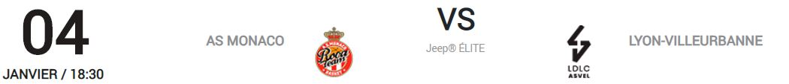
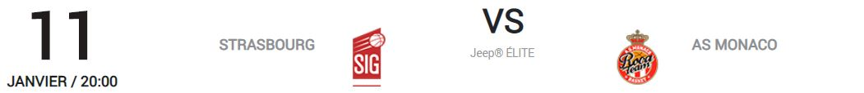
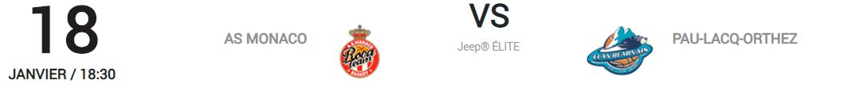
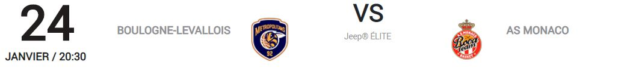
APPENDIX 1: OFFICIAL JEEP ELITE SCHEDULE

Slide 21

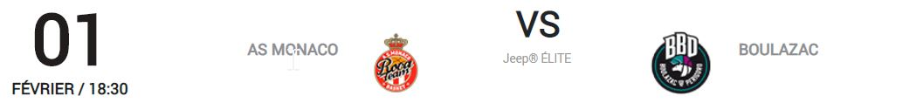
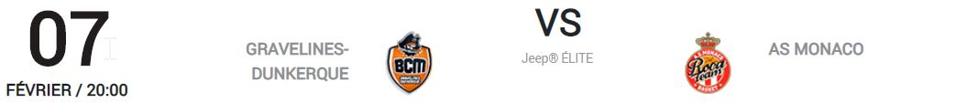
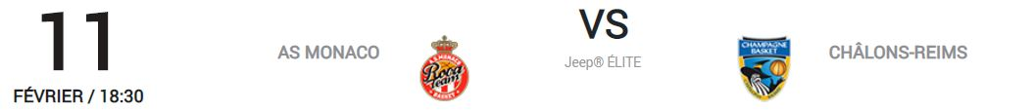
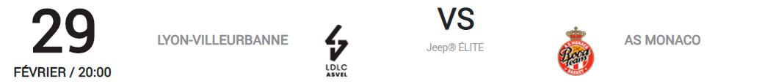
APPENDIX 1: OFFICIAL JEEP ELITE SCHEDULE

Slide 22

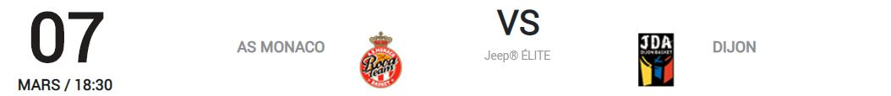
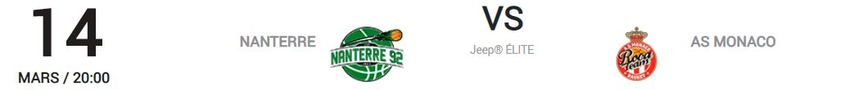
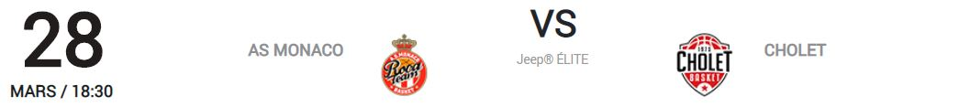
APPENDIX 1: OFFICIAL JEEP ELITE SCHEDULE

Slide 23






APPENDIX 1: OFFICIAL JEEP ELITE SCHEDULE

Slide 24



APPENDIX 1: OFFICIAL JEEP ELITE SCHEDULE

Slide 25





APPENDIX 2: OFFICIAL 7DAYS EUROCUP SCHEDULE

Slide 26







APPENDIX 2: OFFICIAL 7DAYS EUROCUP SCHEDULE

